Slide 1
Jon Barnes
Dell Channel Account Manager
Tech Data Client Systems Partner Summit
June 17, 2010

Slide 2
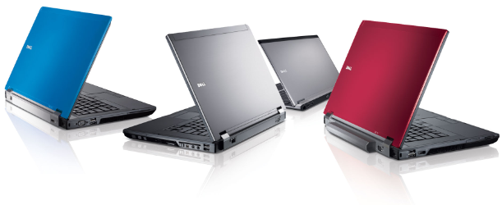
Agenda
Why is Dell in distribution?
Why should I consider Dell?
What about pricing and channel conflict?
Current product offerings
Q&A

Slide 3
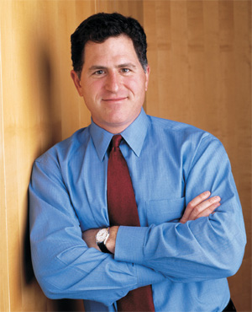
A Brief History
“Direct is not a religion- it’s a business model.”
#1 Global Share
Michael Dell- CEO
Dell Founded
On-Site Services
Fortune 500
IPO
Dell.com
Retail
Mall kiosks
Dallas store
Retail
Partner Direct
Distribution
1984
1988
1989
1992
1996
2001
2007
1990
2007
2009
2005
2006
2007
Fact: 26% of Dell’s commercial revenue came from indirect channels in FY’10 (22% YoY growth)
Notes:
1984: Being direct allowed for customization, reduction in time-to-customer, faster inventory turns, faster product innovation
1990: Initial launch into Retail unsuccessful
90’s: International growth, met with mixed success due to indirect nature of businesses
1996: Dell.com strengthened Direct relationships
1996-2007: The market evolved (customers became more comfortable with technology, IT budgets were developed, our competition reacted)
2007: Michael brought back as CEO, re-launched retail partnerships with Walmart, Staples, etc.
2007: International distribution deals
2007-2008: Launched PartnerDirect: many lessons learned and Distribution is one of those
2009: Greg Davis, our VP of Global Commerical Channels, was named #9 Channel Sales Leader by CRN

Slide 4
Dell in Distribution- Value Proposition
Sales / Support
In-stock “hot seller” popular configurations for rapid delivery
Configure-to-Order
Drop ship capabilities
Dedicated Tech Data and Dell resources:
Doug Abraham - Tech Data PSC
Ryan Svor - Dell ISR
Jon Barnes - Dell CAM
Pricing
“Street-level parity” pricing
Channel Promotions
Special Bid Pricing
Deal Registration
Notes:
We are working on some exciting new changes, so look for announcements as new programs become available.

Slide 5
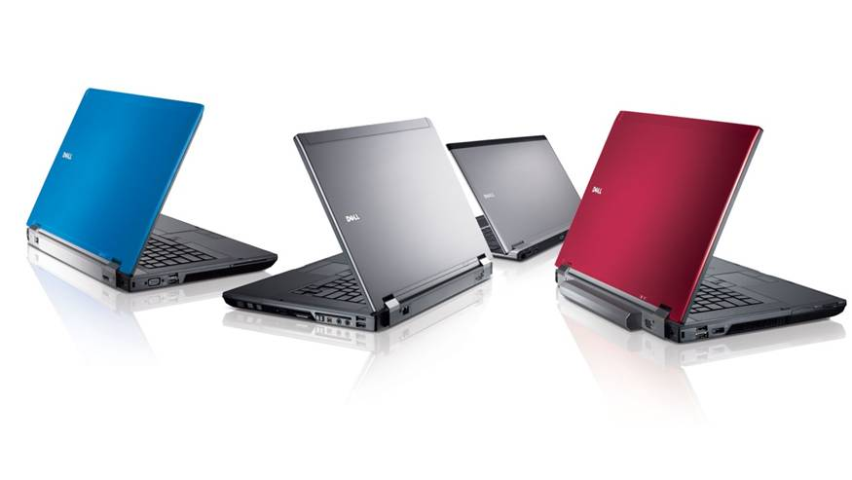
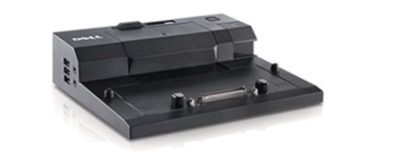
Distribution Promotions
Instant Savings
Monitor Bundles – Optiplex & Vostro PC’s
$50 off E2010H
$30 off P190S
Docking Station Bundles – Latitude E Series
$40 off E-Port Replicator
Promotions Line Card
Available upon request
Add You To Weekly Distribution List

Slide 6

Managing Channel Vs Direct Conflict
Deal Registration
$15k for SMB End-Users (Typically <500 Employees)
$25k for SLED / HCLS (Enterprise Products Only)
$50k for All Other Account Types
First Come – First Serve
Dual Compensation
72% approval rate in 2009

Slide 7
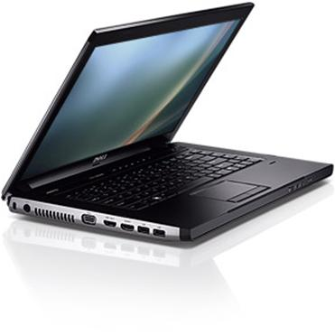
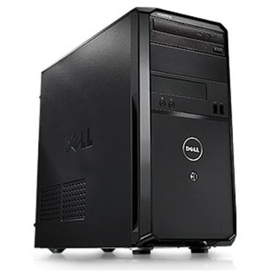
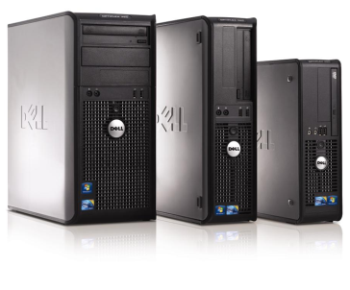
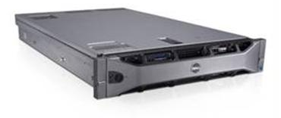
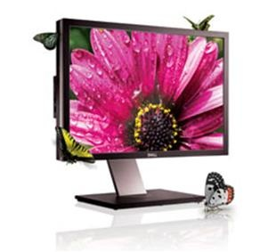
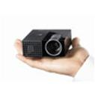
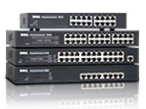
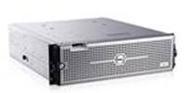
Product Availability
Current Inventory
Medium & Large Businesses
Latitude™ Laptops
OptiPlex™ Desktops
PowerEdge™ Servers
Peripherals
Dell™ Projectors
Dell™ Monitors
Select system /sever options
Small Businesses
Vostro™ Laptops
Vostro™ Desktops
CTO and/or Drop Ship
PowerVault™ Storage, PowerConnect™ Networking Hardware
Precision™ Workstations
Note: CTO and deal-registration may be required to access some products / features
Notes:
If asked, EqualLogic, and Consumer products such as Alienware, Inspiron, Studio, etc. are not currently available through distribution
Services are available on a limited basis

Slide 8
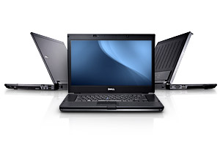
Latitude™ E6410, E6510, E5410, E5510- Medium & Large End-Users
Dependable Design
Mobile Collaboration
Business-class control
Intelligent Productivity
Inter-Compatible Family
Highly Accelerated Life Tests
MIL-STD 810G tested
Dell StrikeZone™
Dell TriMetal™ design
Dependable Technologies
Solid State Drives
Free Fall Sensors on motherboard
Professional Style
Choice of colors
Lightweight
Durable Design
Intense Testing
Webcam & digital array microphone
Mobile Broadband option
Natural Interaction
Multi-touch touchpad
Back-lit keyboards
Practical Environment
Energy-efficient features
Long-Life Stability
Long lifecycles with managed transitions
Image Stability
Management & Security
Remote manageable
Data protection
ProSupport Services
Worldwide 24/7
IT or End-User support
Docking & Peripherals
Tested in extreme temperatures, dry & wet conditions
Premium Panel Guarantee
Dell Latitude ON™ for instant access to email, calendar, contacts and web browsing
3yr long-life batteries, battery-slice options
Thin & light AC adapters
Note: CTO and deal-registration may be required to access some products / features
Notes:
Long lifecycles
Commonality- docking solutions, peripherals, AC adapters
E6X10 series compare to HP EliteBook: features new Intel i-Core processors and DDR-3 memory
E5X10 series compare to HP ProBook: features new Intel i-Core processors and DDR-3 memory
Via CTO, we also have tablets, ruggedized, classroom-ready, and ultra-thin and light versions
Latitude E-family carries Premium Panel Guarantee: 100% zero bright dots on LCD panels or free exchange
E-Family lifecycle target- 5 years

Slide 9



Latitude Competitive Matrix
Platform
Mainstream
14” | Latitude E6410 | EliteBook 8440p | ThinkPad T410
15” | Latitude E6510 | EliteBook 8540p | ThinkPad T510
Essential
14” | Latitude E5410 | ProBook 6440b | ThinkPad L412
15” | Latitude E5510 | ProBook 6540b | ThinkPad L512

Slide 10

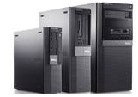
OptiPlex™ 380MT, 380DT, 380SFF, 780MT, 780SFF- Medium & Large End-Users
3-Year Warranty
North-American based
Customizable for end-user or IT
Managed 60-90 Day Image Transitions
Long Lifecycles- Up to 24 Month
Designed for Productivity
Tool-less chassis design speeds maintenance, lowers costs
Highly customizable features can meet your unique workforce requirements
High performing, energy efficient
Management tools and services that simplify and save
Client Manager™ comprehensive remote system management
Dependable deployment and migration
Energy Efficient
EPEAT GOLD and ENERGY STAR 5.0 certified
Up to 90% efficient power supplies
Energy Smart™ settings
89% recyclable packaging, BFR and PVC-free
Anti Chassis Intrusion design to help protect internal components from theft
Chassis Intrusion switch
Security Slot
Network Alerts
CFI Asset Tags
CFI Security Labels
OptiPlex built-in security features
Full disk encryption, RAID 1
Smartcard options
Pre-boot authentication
TPM 1.2 on select models
VPN access support
Leading-edge security tools
Client isolation, remote patching
Dell ControlPoint and anti-malware software
Intel AMT Circuit Breaker client isolation
Stable
Secure
Manageable
Note: CTO and deal-registration may be required to access some products / features
Notes:
Opti 380 series compares to HP Compaq dx2450, HP Compaq 500B, or HP Pro 3000
Opti 780 series compares to HP Compaq dc5800, HP Compaq 6000 Pro, HP Compaq dc7900, HP Compaq 8000 Elite

Slide 11


OptiPlex Competitive Matrix
Platform
Premier
 | 980 | Compaq 8100 Elite | ThinkCentre M90/M90p | Esprimo P9900 Esprimo E9900 | -
Mainstream
 | 780 | Compaq 8000 Elite HP 8000 Elite (USFF) Compaq 6000 Pro | ThinkCentre M58/M58p | Esprimo P7936 Esprimo E7936 | Veriton M670G
Essential
 | 380 | Pro 3000 (3010) | ThinkCentre A58 ThinkCentre M58e | Esprimo P3521 Esprimo E3521 | Veriton M265 Veriton L460G

Slide 12
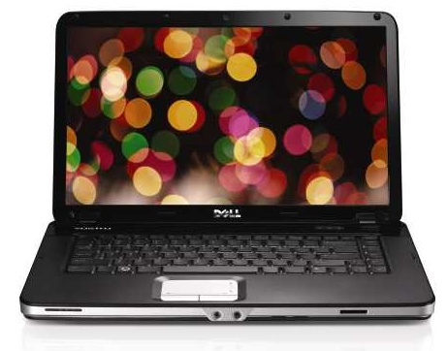

Vostro™ 1015, V3X00- Small Business End-Users
Vostro™ Laptops
“Essential” value-oriented series- easy to buy, easy to own
Vostro™ 1015 (15.6”)
Standard 2.0MP webcam, 802.11b/g/n, DVD burner, 1-yr NBD warranty, Microsoft® Office Ready 2007
Choice of Windows® 7 Home Premium or Professional
Vostro V3300 (13.3”), V3400 (14.0”), V3500 (15.6”), V3700 (17.3”)
Intel® i-Core processor, DDR3 memory
Standard 2.0MP webcam, 802.11b/g/n, DVD burner, 1-yr NBD warranty, Microsoft® Office Ready 2007, free-fall sensor, HDMI (14” and up),
Optional discrete graphics, fingerprint reader
Note: CTO and deal-registration may be required to access some products / features
Notes:
Vostro 1015 compares to HP Compaq 610/615, Acer Extensa 4630, or Lenovo SL
Vostro 3X00 compares to HP ProBook 4xxx series, Acer TravelMate X730, or Lenovo SL 300, 410, 510

Slide 13
Vostro Notebook Competitive Matrix
Platform
Essential
14” | Vostro 3400 | ProBook 4420s | ThinkPad SL410
15” | Vostro 3500 | ProBook 4520s | ThinkPad SL510
17” | Vostro 3700 | ProBook 4720s
Essential - Value
15” | Vostro 1015 | HP 620 | G550

Slide 14
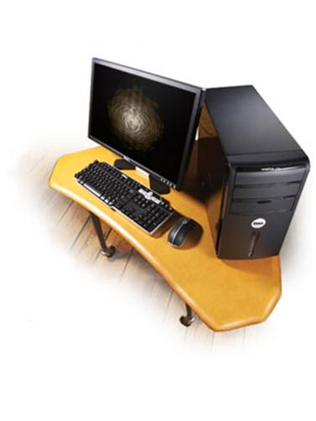
Vostro™ 230MT, 430MT- Small Business End-Users
Vostro Desktops- “Mainstream” value-oriented series
Expandable and reliable for everyday business needs
Vostro™ 230MT
Core™2 Duo processor
DVD burner, 1-yr NBD warranty, Microsoft® Office Ready 2007, DDR3 memory, Windows® 7 Professional
6 external USB, 2 DIMMs, 300W power supply
Note: CTO and deal-registration may be required to access some products / features
Notes:
230MT compares to HP dx2400 or Lenovo ThinkCenter A58
430MT compares to HP dx7500 or Lenovo ThinkStation A58

Slide 15
Vostro Desktop Competitive Matrix
Platform
Mainstream
 | Vostro 230 | Compaq 500B | ThinkCentre A58

Slide 16
Channel Benefits Comparison
 | Dell.com | PartnerDirect | Distribution
Deal registration | ✓ | ✓ | ✓
Configure-to-order | ✓ | ✓ | ✓
Demo units | ✓ | ✓ | ✓
Flexible quantity limits | ✗ | ✓ | ✓
In-stock availability on popular configurations | ✗ | ✗ | ✓
Managed pricing | ✗ | ✗ | ✓
Customized terms and lines of credit (per distributor) | ✗ | ✗ | ✓
Total solutions sale | ✗ | ✗ | ✓
Notes:
Pricing can change weekly
Emails are sent out to notify customers about deals- email Bonnie Duncan if you would like to be included

Slide 17
声明：
所有的版权属于原有公司，文件均来自公开渠道
此文件仅供学习使用，任何人不得进行以此为商业目的的行为
如有疑问，请立即删除
学习世界五百强和咨询公司PPT课程请访问如下网站搜索：“司马懿”
百度传课：司马懿PPT学校
网易学堂：司马懿PPT学校
知乎： 司马懿PPT学校
访问地址
https://www.chuanke.com
访问地址
https://study.163.com
访问地址
https://www.zhiu.com

